Slide 1
CRISPR/Cas9 Gene Editing and PCR

Slide 2
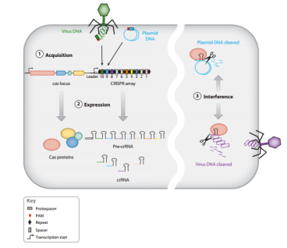
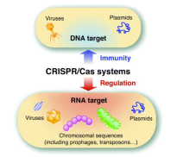
CRISPR: Clustered Regularly Interspaced Palindromic repeats
Cas9: CRISPR-associated protein 9
gRNA: Guide RNA; composed CRISPR RNA and trans-acting RNA
PAM: Protospacer adjacent motif; 5’-NGG or 5’-NAG tolerated in human cells
Immune system for bacteria targeting foreign DNA
20-40 palindromic sequences repeated separated by spacer DNA, which perfectly matches foreign DNA
Cas9 nucleases and cutters target foreign DNA based on RNA transcribed from CRISPR DNA and adjacent spacer DNA, or guide RNA
1) Acquires foreign DNA
2) Synthesis of RNA and formation of RNA-Cas complex
3) Target (foreign DNA) recognition and destruction by Cas nuclease cleavage
https://www.youtube.com/watch?v=2pp17E4E-O8

Slide 3
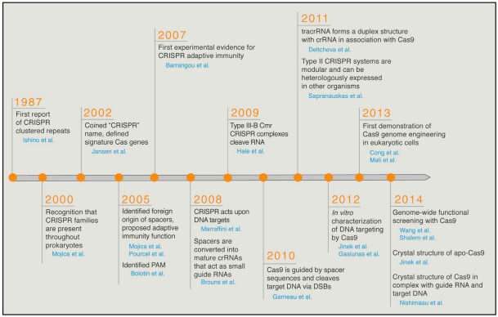

Slide 4
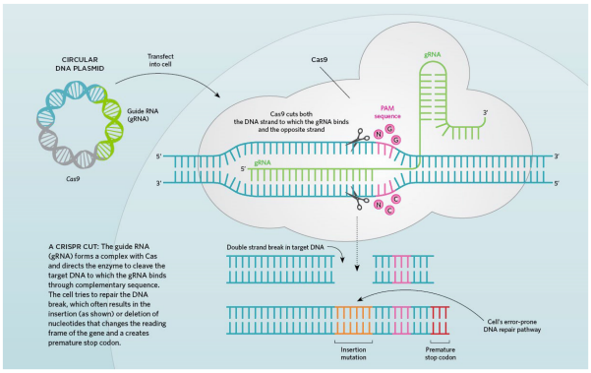
The guide RNA forms a complex with the Cas9 nuclease
This directs the Cas9 to cut the foreign DNA through complementarity (gRNA is complimentary to foreign DNA, therefore base-pairing and bring the Cas9 into proximity of its cleavage site)
This results in insertion or deletion of nucleotides, does not necessarily destroy or “kill” foreign DNA, but changes the reading frame
This insertion or deletion typically renders protein non-functional, or created premature “STOP” codon

Slide 5
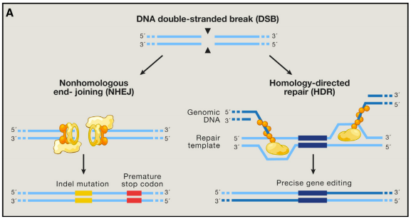
CRISPR/Cas9 can be used for genome editing, but must bring together the nucleotides on either side of the double-strand break
Non-homologous end joining: joining and creating phosphodiester bond between broken DNA molecule, no homology between the ends (leads to truncation and premature “STOP” codon)
Homology-directed repair: essentially homologous-recombination, homology between the broken DNA and another DNA sequence which can be designed and synthesized; this leads to restoration of the normal gene

Slide 6
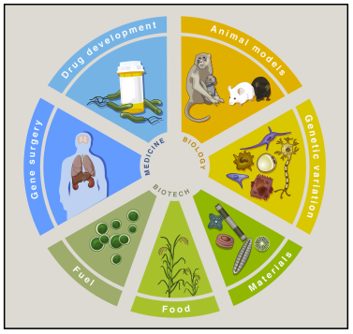
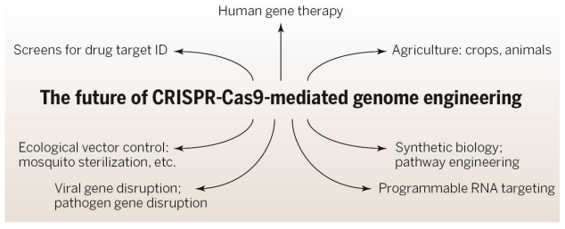
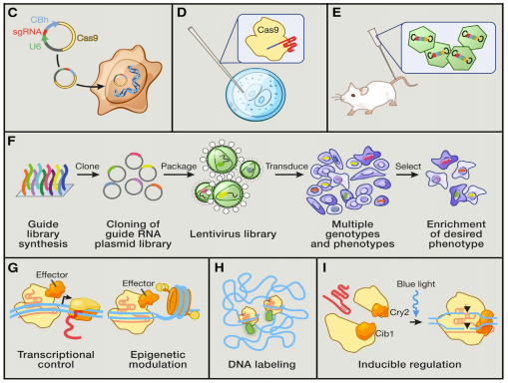
Possible problems to overcome in gene editing:
1) Delivery: Liposomes? Stem Cells? Lentivirus?
2) Off Target Effects: Must sequence whole genome after editing. Paired nicking?
3) Variability: Modify Cas9? Paired nicking? Modified gRNAs?
4) Inter- and intra-chromosomal rearrangement

Slide 7
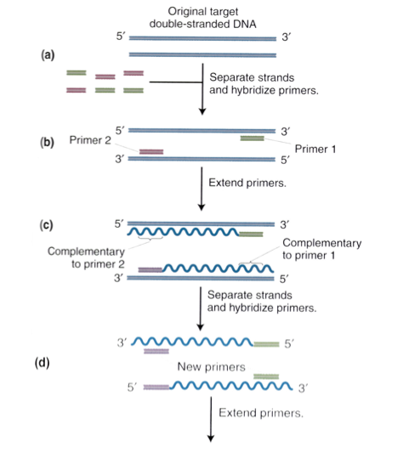
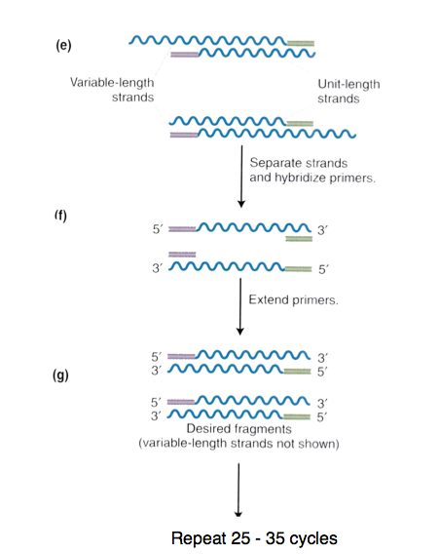
PCR: polymerase chain reaction
Used to amplify specific regions of DNA in vitro
Has many different uses, but ultimately is used to amplify from very small amounts of DNA
Denature DNA -> primers anneal to complementary site in sequence -> DNA extension by Taq/Pfu polymerase (50-70 degrees C) -> cycle repeate 25-25 times, yields billions of copies of DNA sequence

Slide 8
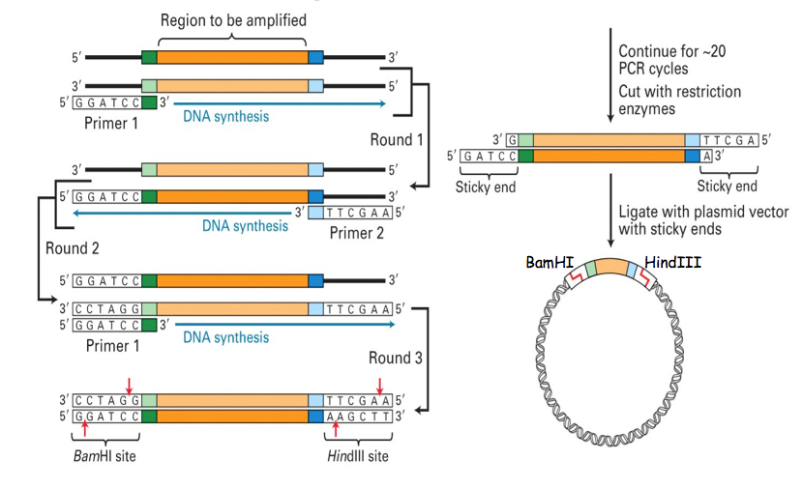

Slide 9
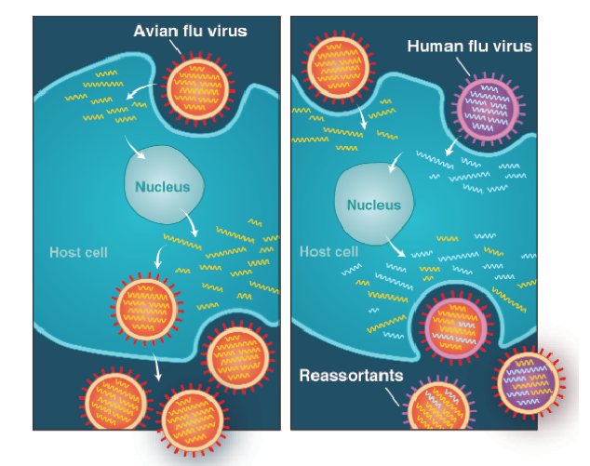
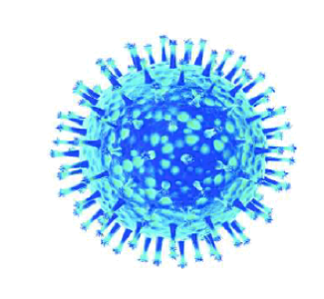
PCR was used to reconstruct the genome of the influenza virus, through reverse transcriptase PCR (RT-PCR)
Hemagglutinin (H): responsible for attachment/infection of influenza particles
Neuraminidase (N): responsible for release of new influenza particles
New influenza strains can occur by mutation (RNA polymerase does not have a proofreading function, only 1-2 changes can yield completely different viruses) and reassortment which occurs when two different flue viruses infect and replicate within a host, which can cause them to swap genome segments

Slide 10
Screening Libraries and Microarrays

Slide 11
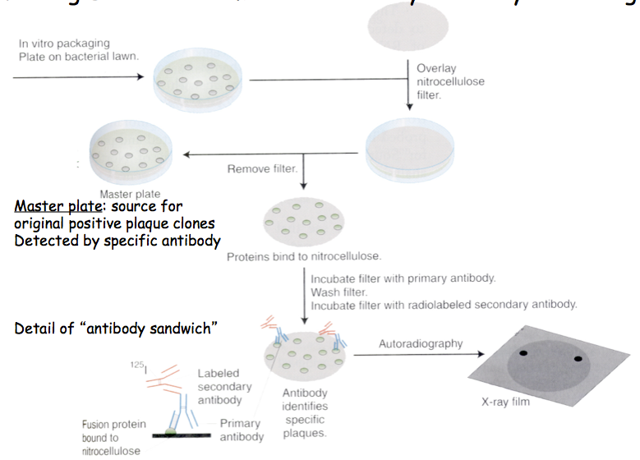
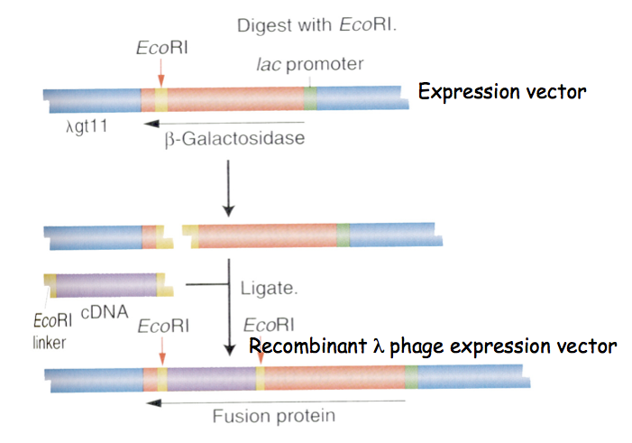
Select for expression of cloned gene in a mutant cell background (commonly bacteria or yeast), called complementation
Utilizes cell strain defective in the gene of interest (E. coli that possess defective lacZ gene, for instance, would not be able to grow in lactose media)
Transform these cells with antibiotic resistant vector containing wild type function of the gene, and grow in conditions that would only allow the cell to grow if the plasmid is successfully transformed
Isolated colonies will have the recombinant clone present
DNA inserts (cDNA typically) inserted in-frame with the coding sequence, translated in the host to create chimeric fusion proteins and colonies or plaques are specifically labeled with antibodies or other molecules known to bind the protein of interest

Slide 12
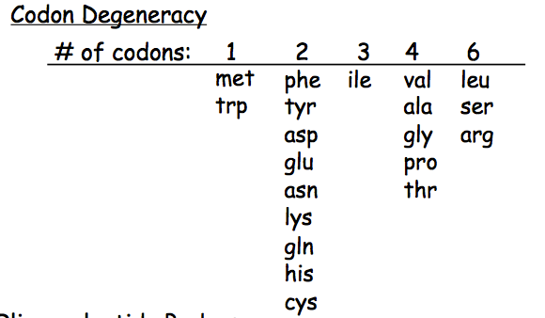
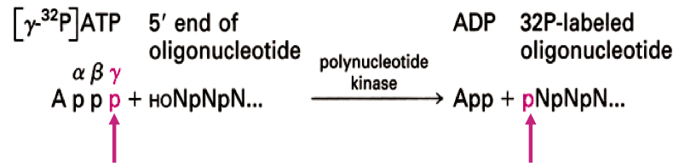
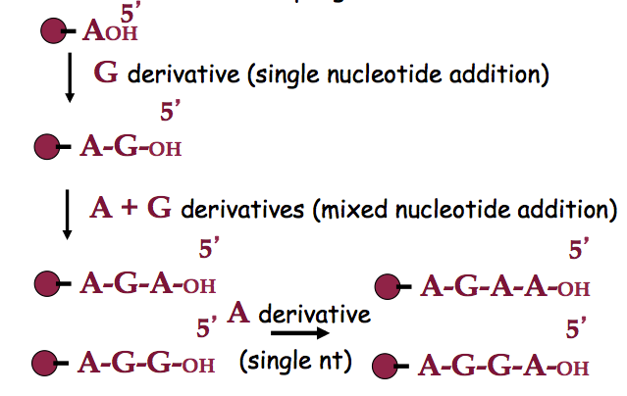
Synthesize a DNA probe set containing all possible coding sequences for a peptide (“fully degenerate probe”)
Sequential addition of reactive nucleotide derivatives in the 3’ -> 5’ direction
Mixed probes created by providing more than one nucleotide at the same time
Phosphatase may be requires to remove 5’ phosphate group from DNA fragment (unless chemically synthesized) and kinase used to add 32P-phosphate to DNA
Labeled probe used to screen libraries using hybridization

Slide 13
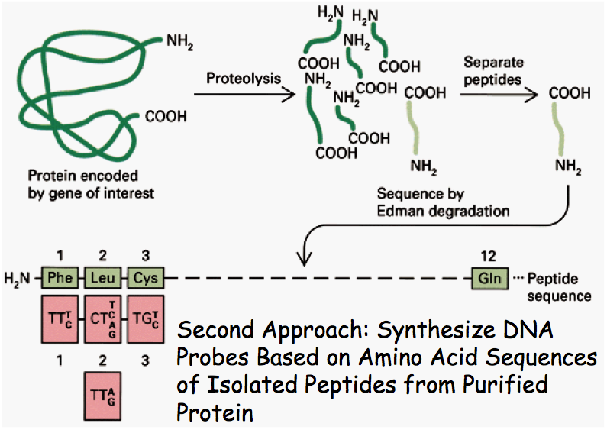
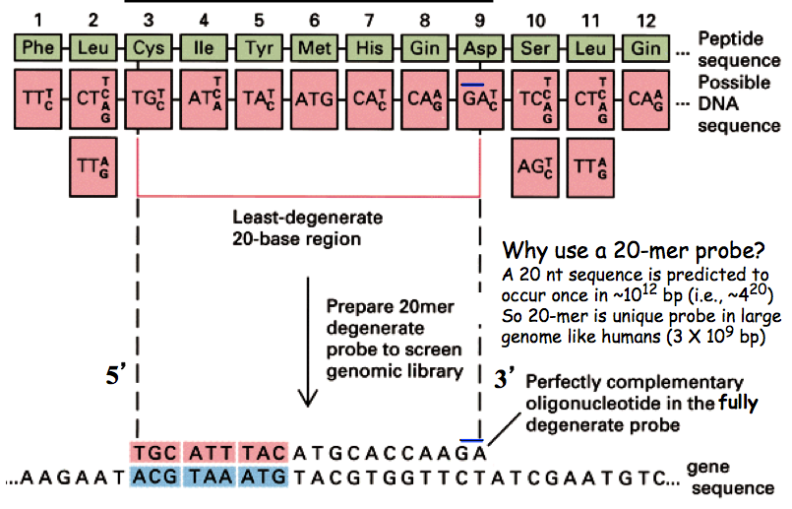
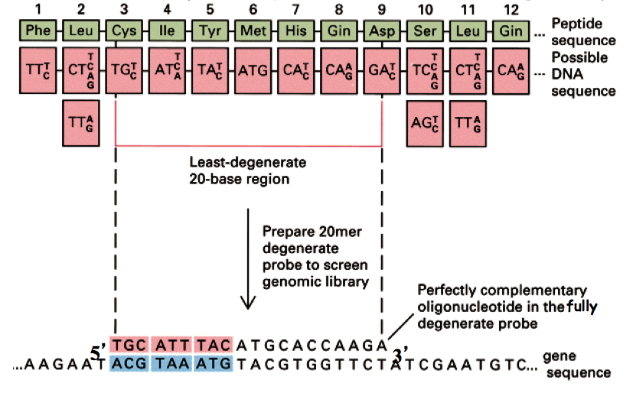
Synthesize DNA probe based on amino acid sequence of purified protein of interest
Select the peptide with the lowest degeneracy (meaning the lease number of codons that could possibly encode the protein sequence)
20-mer probe large enough that its uniqueness is virtually guaranteed

Slide 14
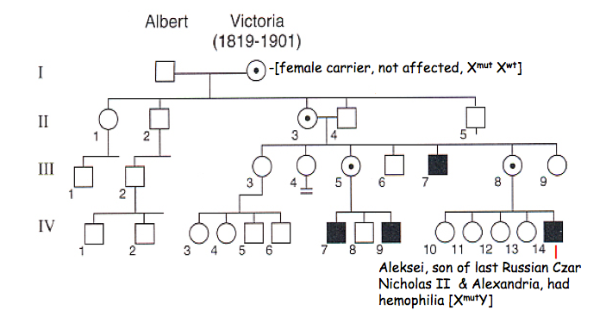
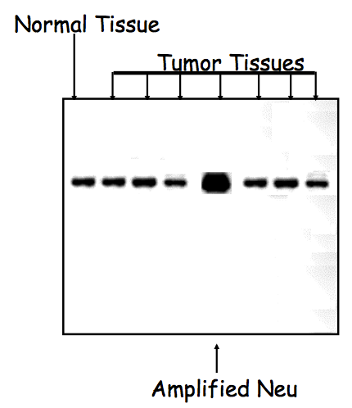
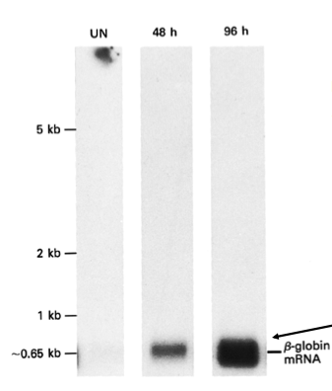
Hemophilia is an inherited disorder, through pedigree analysis geneticists were able to determine that the mutation occurs on the X-chromosome
Used reverse genetics to determined the gene structure, starting with the purified protein and amino acid sequence
Labeled DNA or RNA probes that are complementary to gene of interest can be used to screen libraries
Southern blots (DNA) and Norther blots (RNA) can determine presence of DNA or RNA, gene structure, and relative expression level

Slide 15
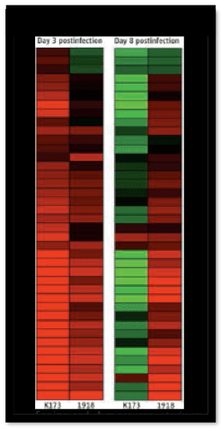
Microarrays: quantitative method using fluorescence to determine mRNA levels by hybridization to specific DNAs bound and displayed on a small chip or array
cDNA arrays, synthetic DNA oligonucleotide arrays, PCR-generated exon-specific arrays (exons in human genome can be arrayed on one chip, the “exome”), genome tiling arrays (50-mer oligonucleotides across entire genome, to survey coding and non-coding RNAs, “transcriptome”)
Determine why the 1918 influenza was particularly fatal by determining over expression of inflammatory proteins

